Slide 1

Toolkit Doc3 Gripper
May 5, 2010

Slide 2
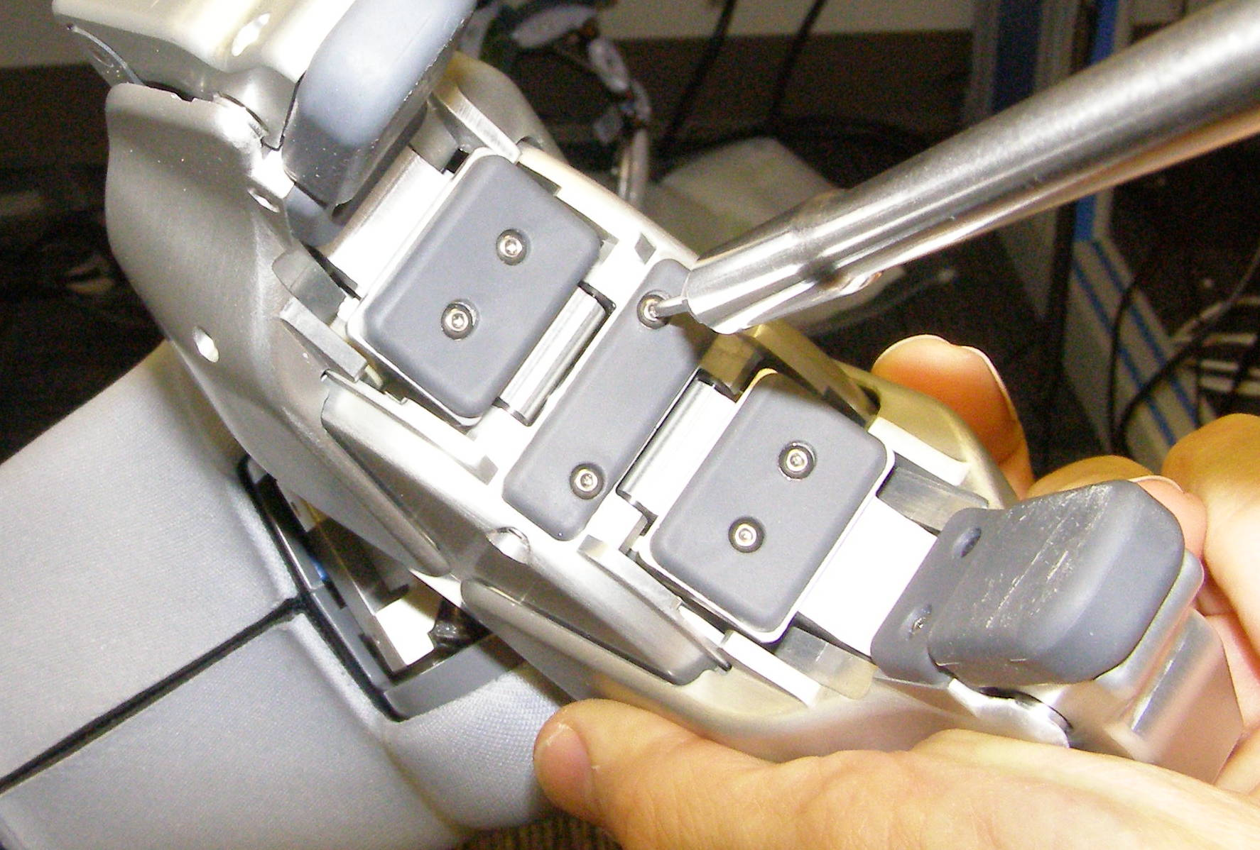
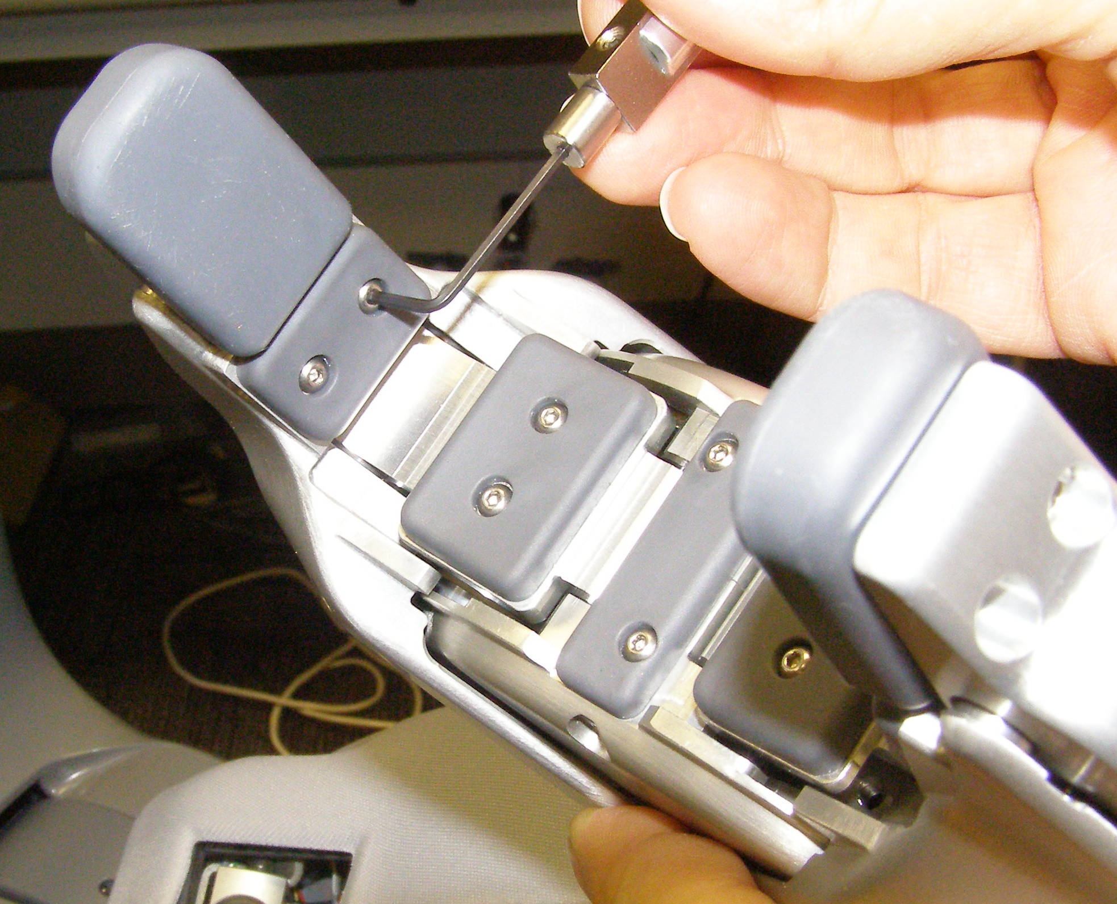
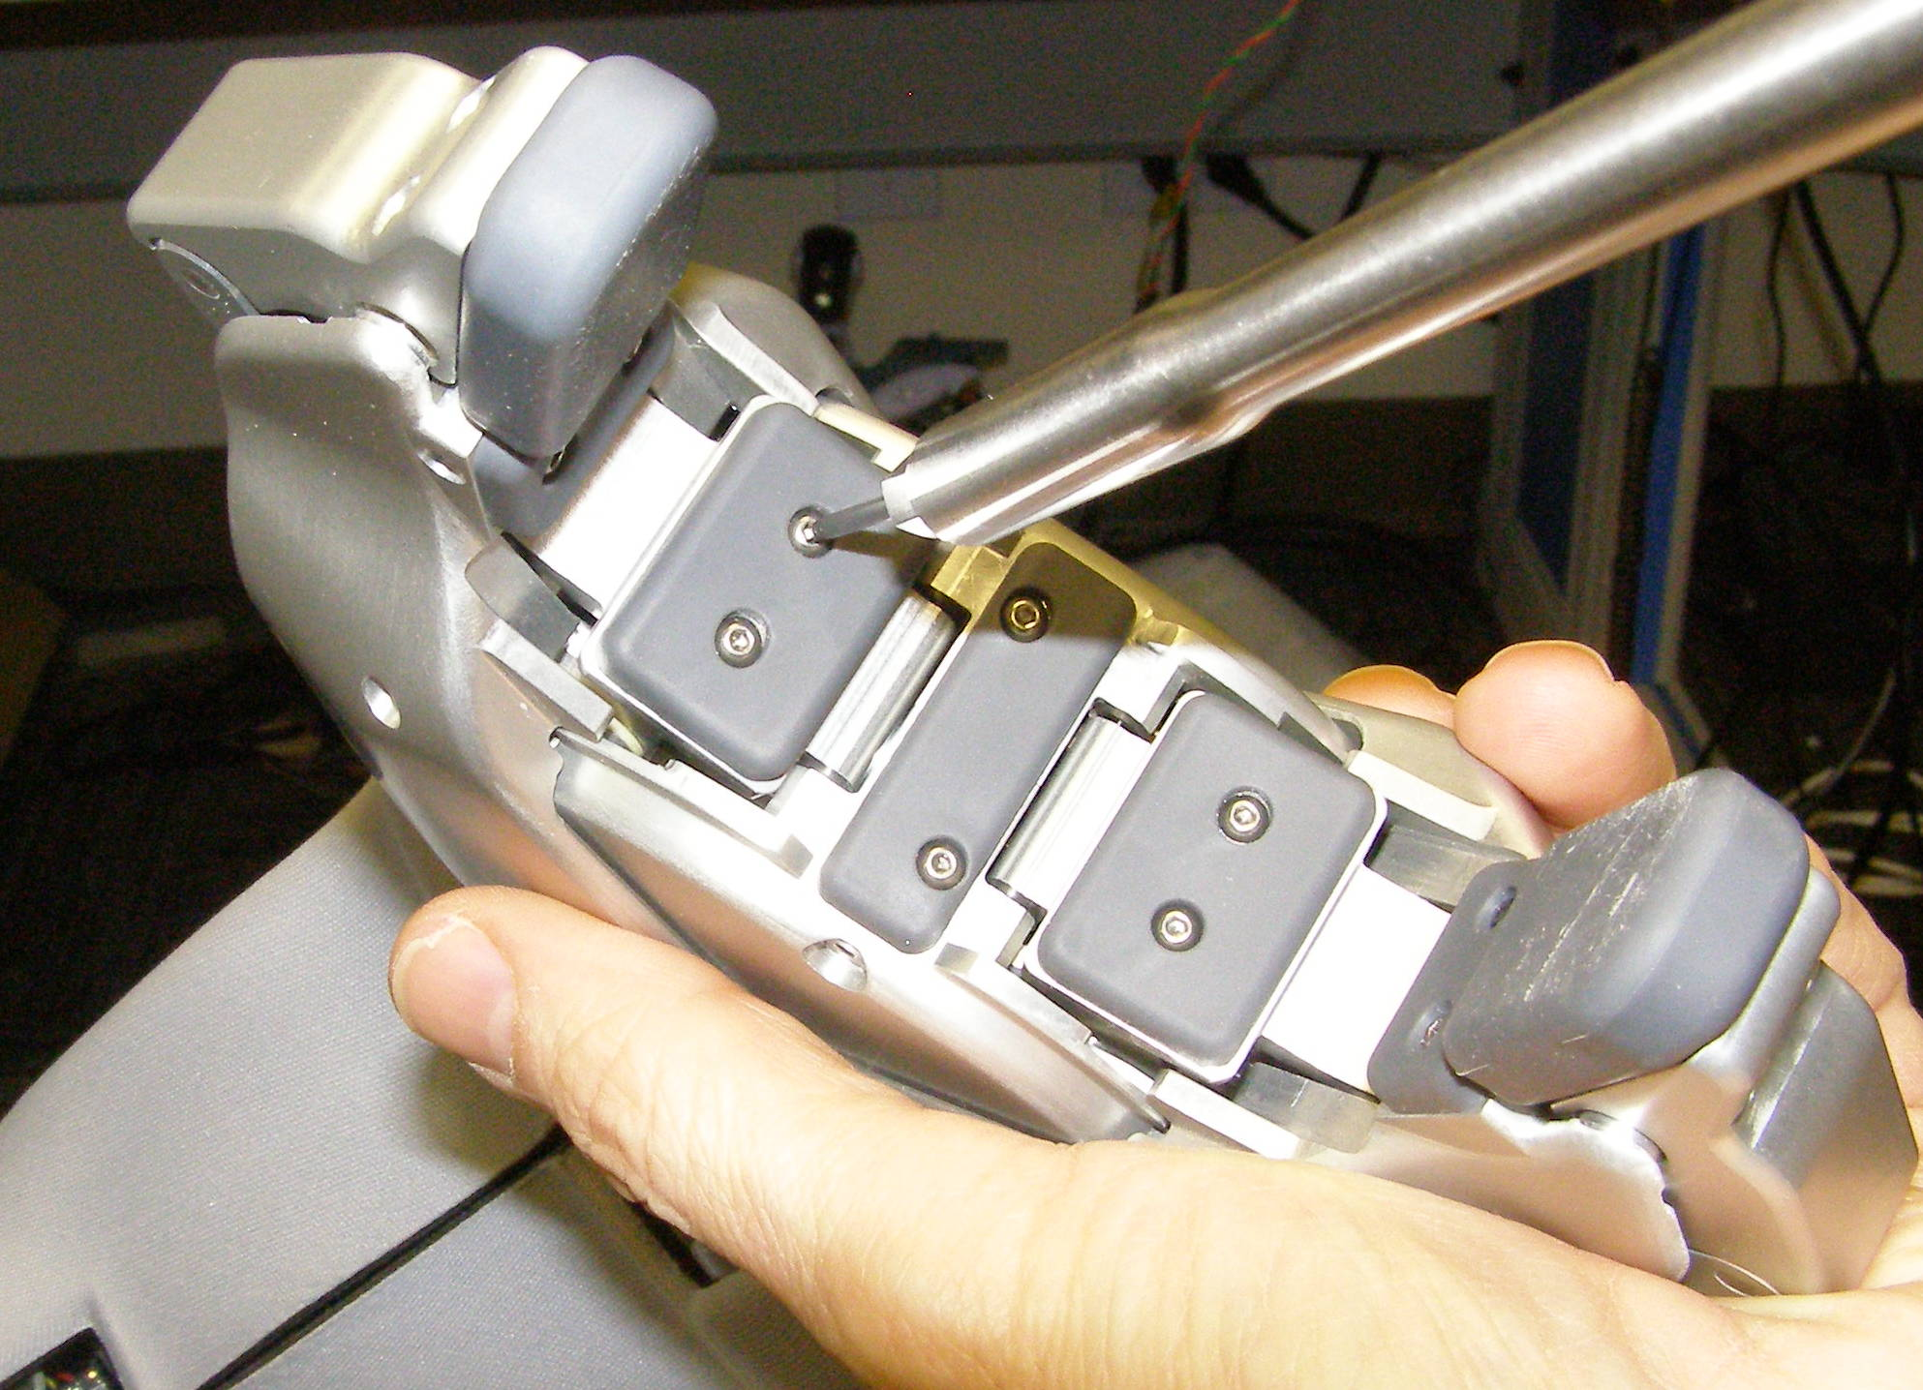
Gripper Pads R/R
Palm Grip Pad, Removal – 2296
  Using the 1.5mm bit with the T-handle driver, remove the screws. 2500-04 (Fig 1)
Link5 Grip Pad, Removal – 2281
  Using the 1.5mm bit with the T-handle driver, remove the screws. 2500-04 (Fig 2)
Finger Grip Pad, Removal – 2275
  Using the 1.5mm right angle torque wrench, remove the screws. 2500-04 (Fig 3)
Grip Pads, Install
  Reverse the removal procedures.
  Using Loctite 248, install the screws and torque to 0.34Nm using the Small torque driver or the right angle torque wrench for the Finger Grip Pads.
Fig 1
Fig 3
Fig 2
Fig 4

Slide 3
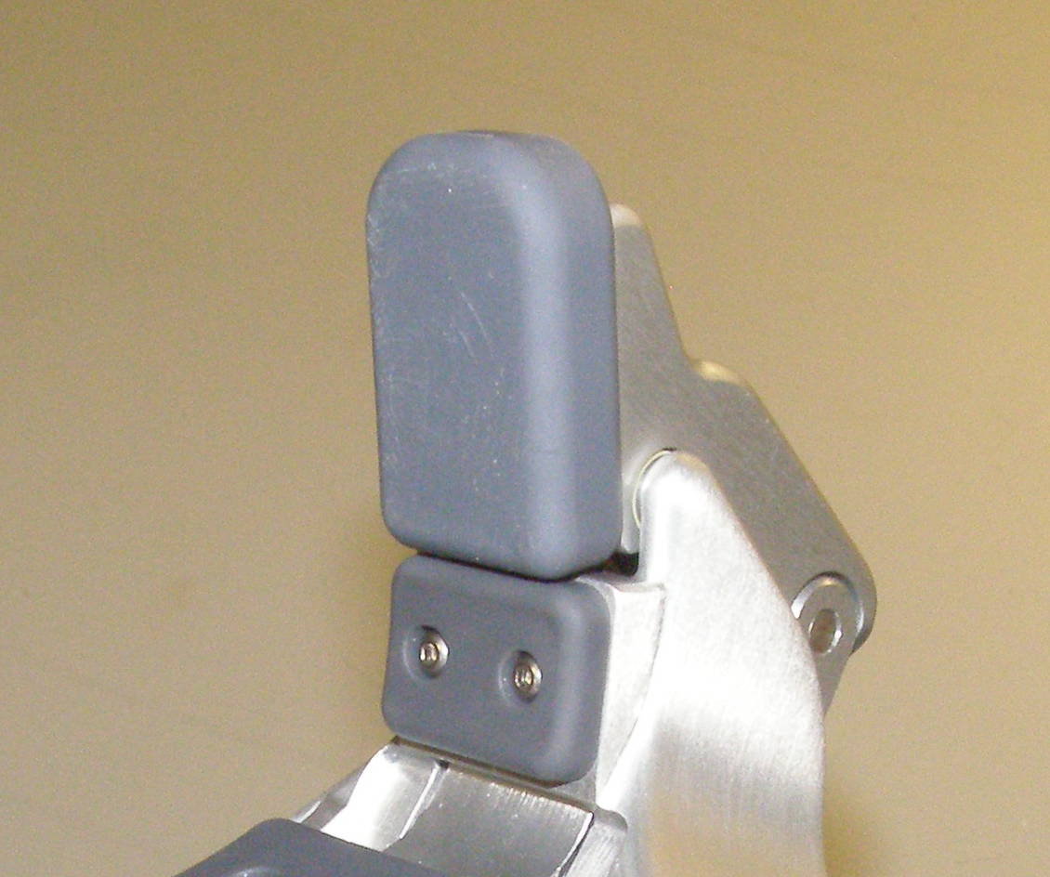
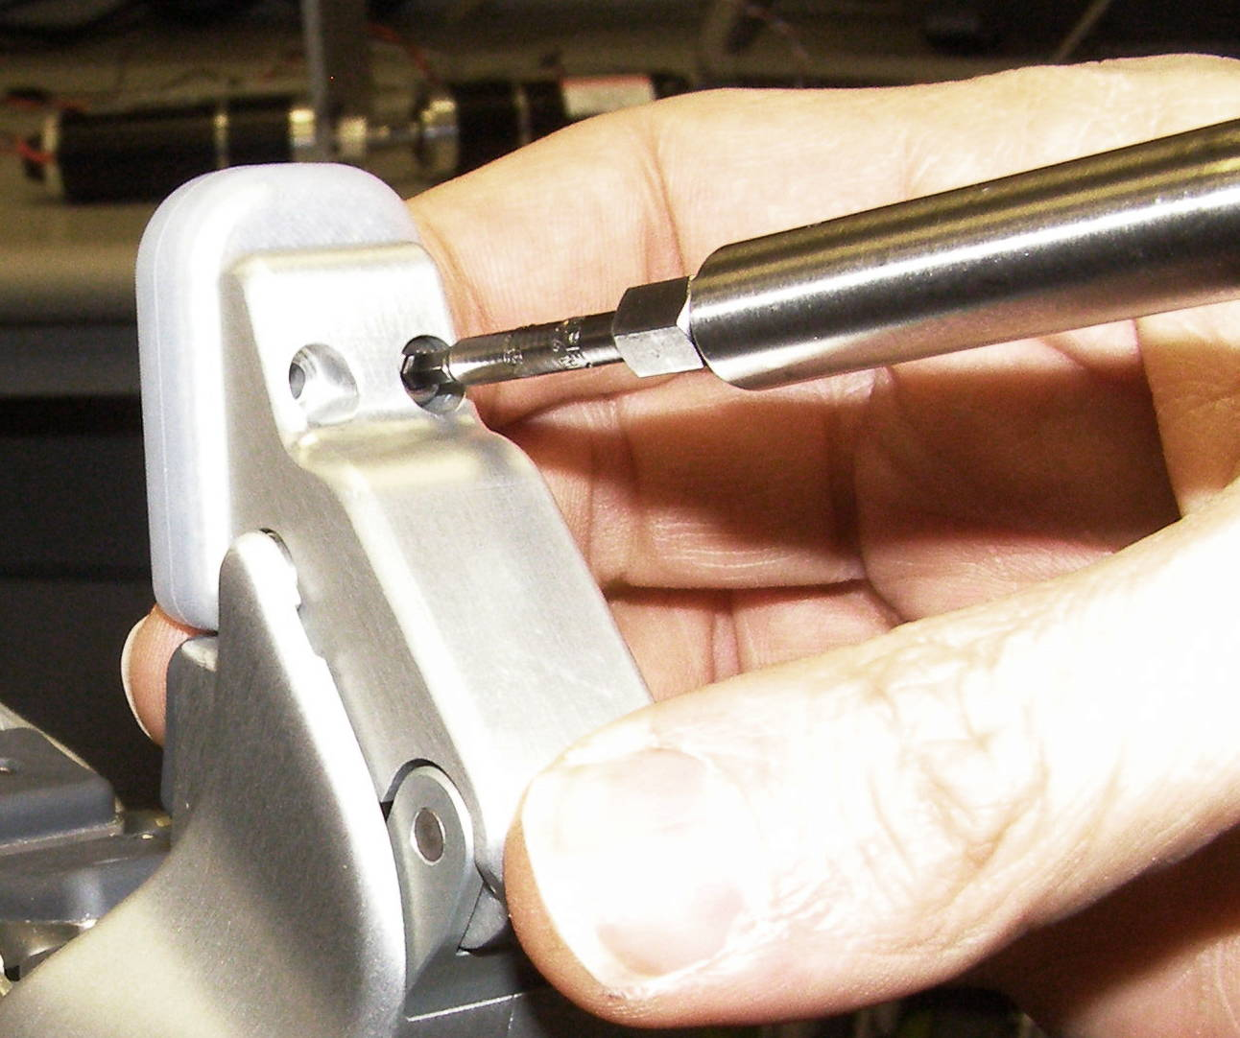
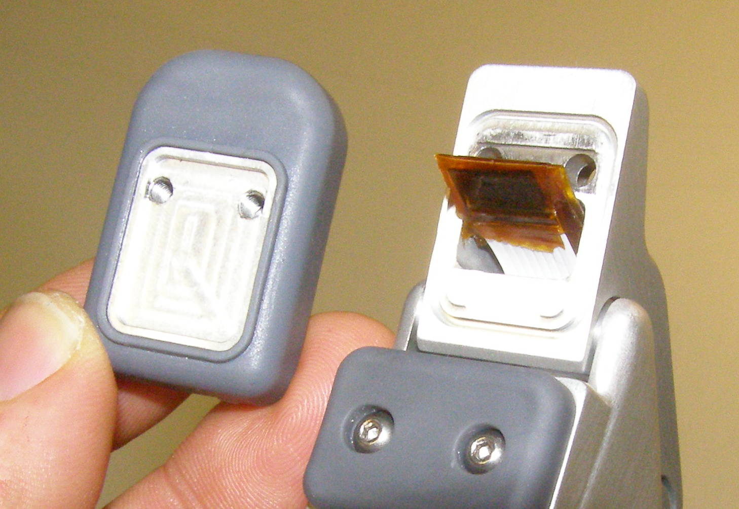
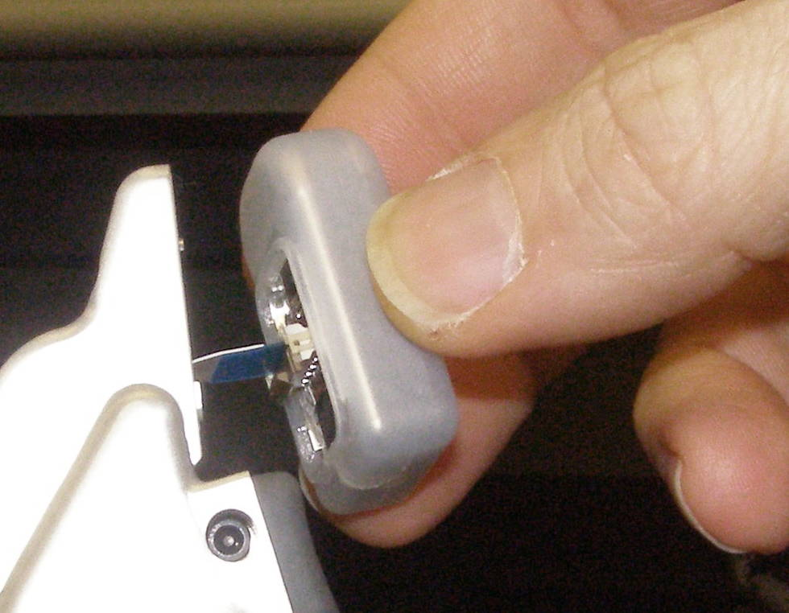
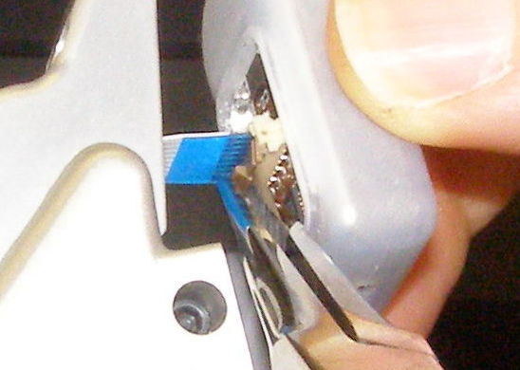
Gripper Tips R/R (1)
Gripper Tips, Removal – 2295 (Dummy, Gray)
Gripper Tips, Removal – 1079
  Using the 2.5mm bit with the T-handle driver, remove the 2 screws. 3062-08 (Fig 1,2)
  Using the Needle Nose pliers flip the connector latch away from the Gripper Tip to release the flat flex cable. (Fig 4,5)
Gripper Tips, Install (Dummy)
  Make sure the cable end is covered with insulating tape so its conductors cannot make contact with the metal housing. (Tape not provided) (Fig 6)
  Using Loctite 248, install the screws and torque to 1.36Nm using the Large torque driver.
Fig 1
Dummy
Fig 6
Fig 2
Fig 4
Fig 5

Slide 4
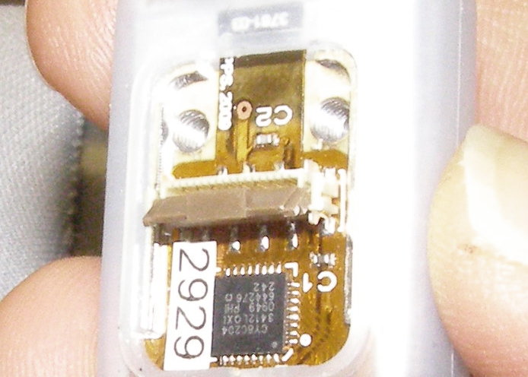
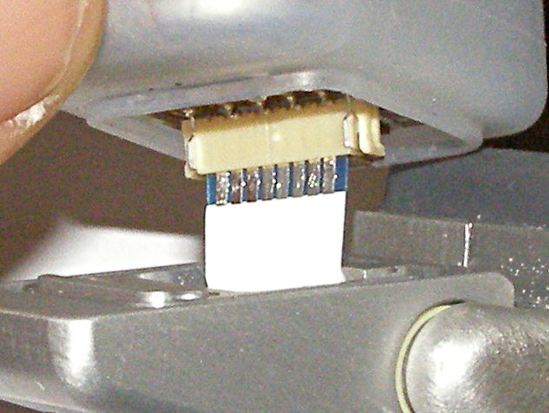
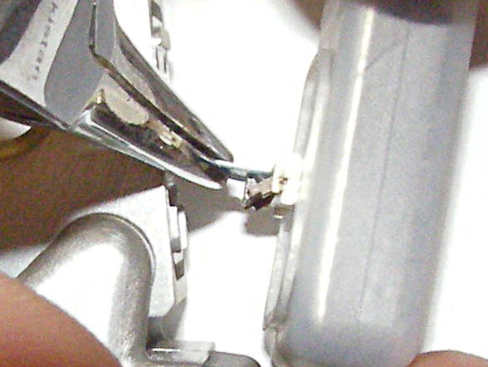
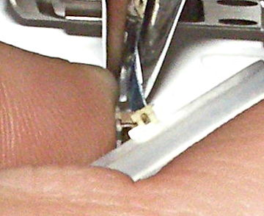
Gripper Tips R/R (2)
Gripper Tips, Install
  Make sure the connector latch is flipped out before inserting flat flex cable. (Fig 7)
  Using the Needle Nose pliers insert the Flat Flex Cable into the connector. (Fig 8)
  With the cable inserted squarely into the connector, flip the latch towards the Gripper Tip to lock the cable being careful not to allow the cable to slip back out in the process.
  (Fig 9)
  The Flat Flex Cable should be even with the connector as shown. (Fig 10)
  Using Loctite 248, install the screws and torque to 1.36Nm using the Large torque driver.
Fig 7
Fig 10
Fig 8
Fig 9

Slide 5
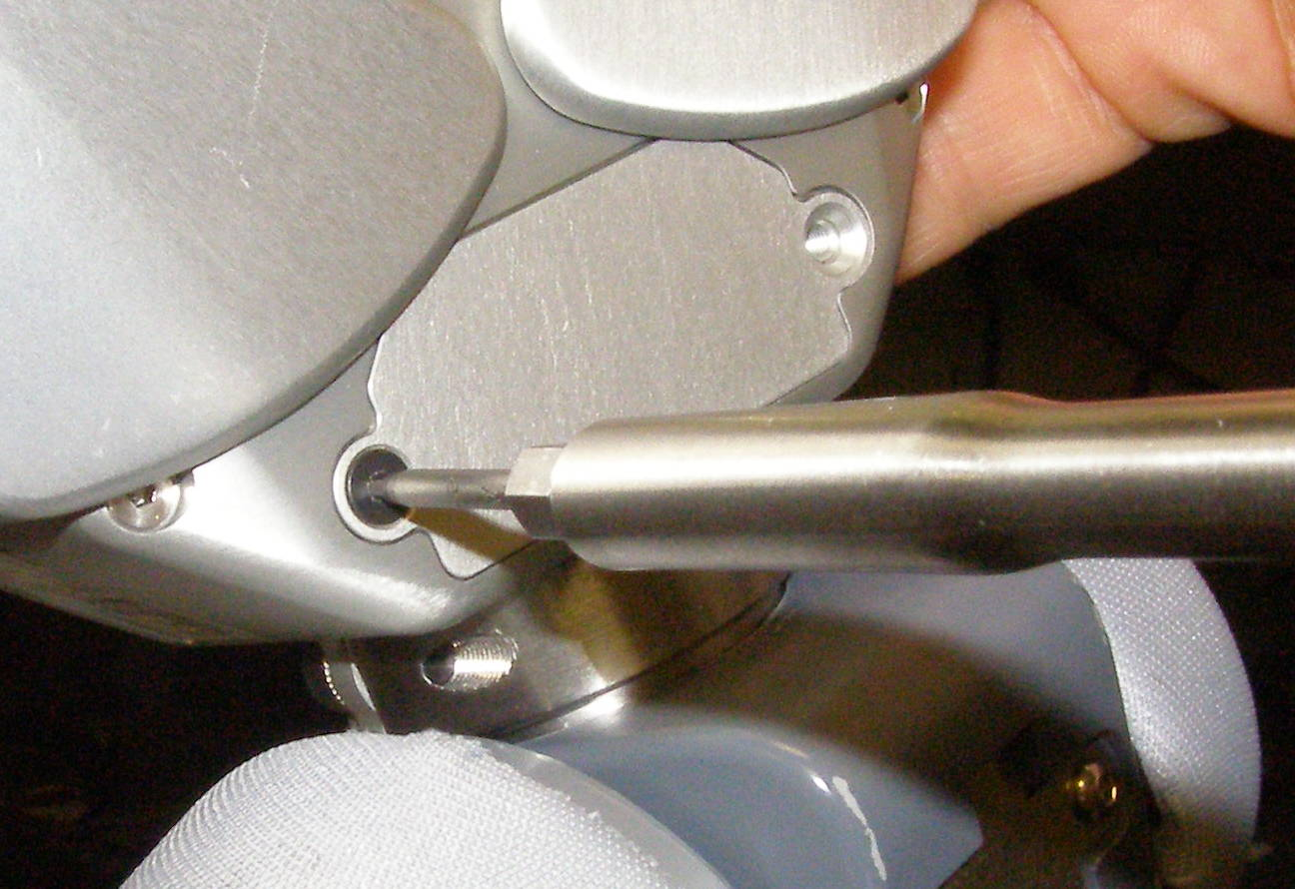
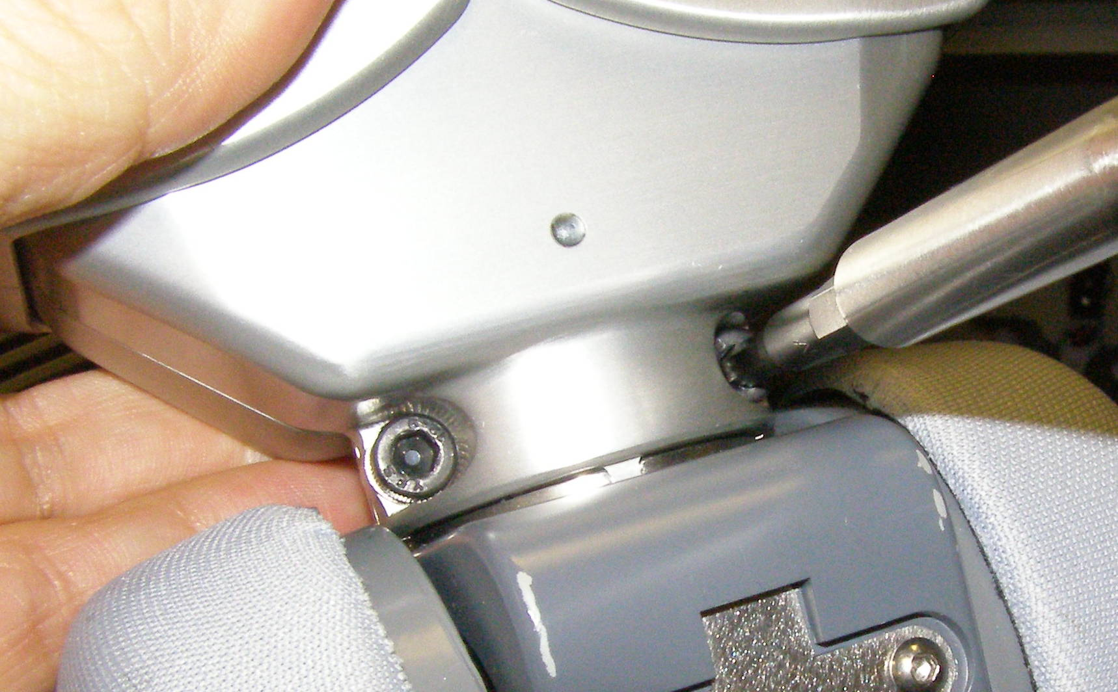
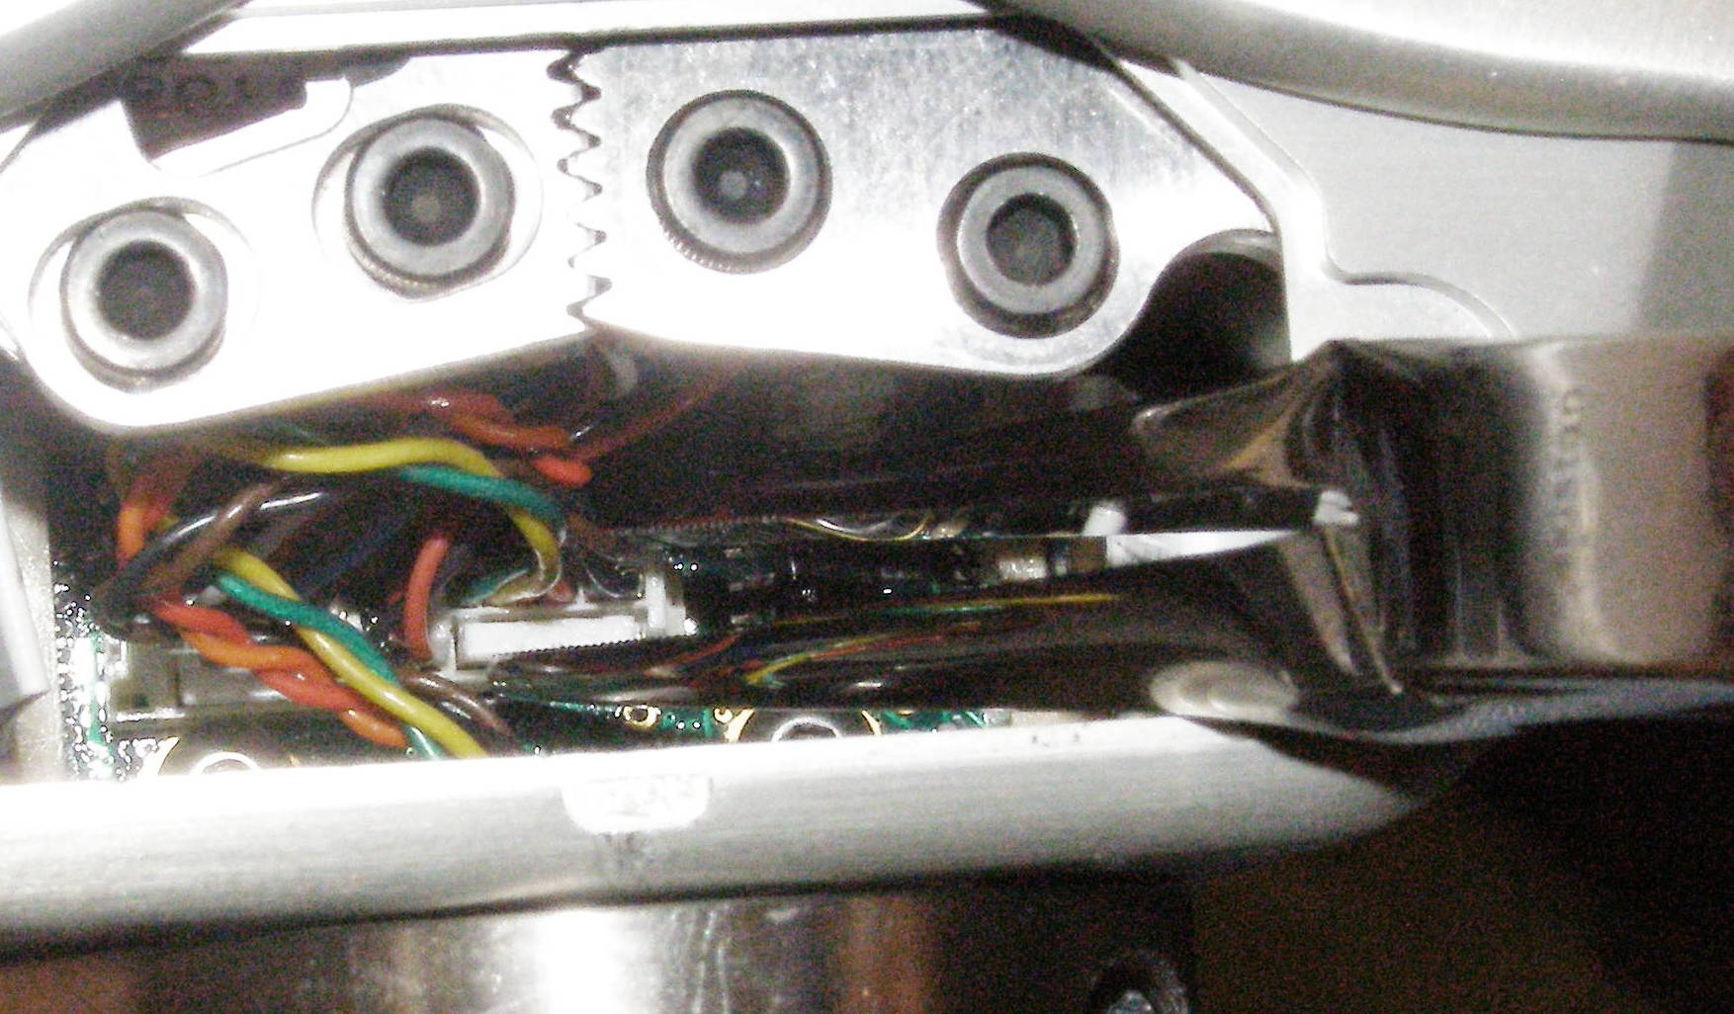
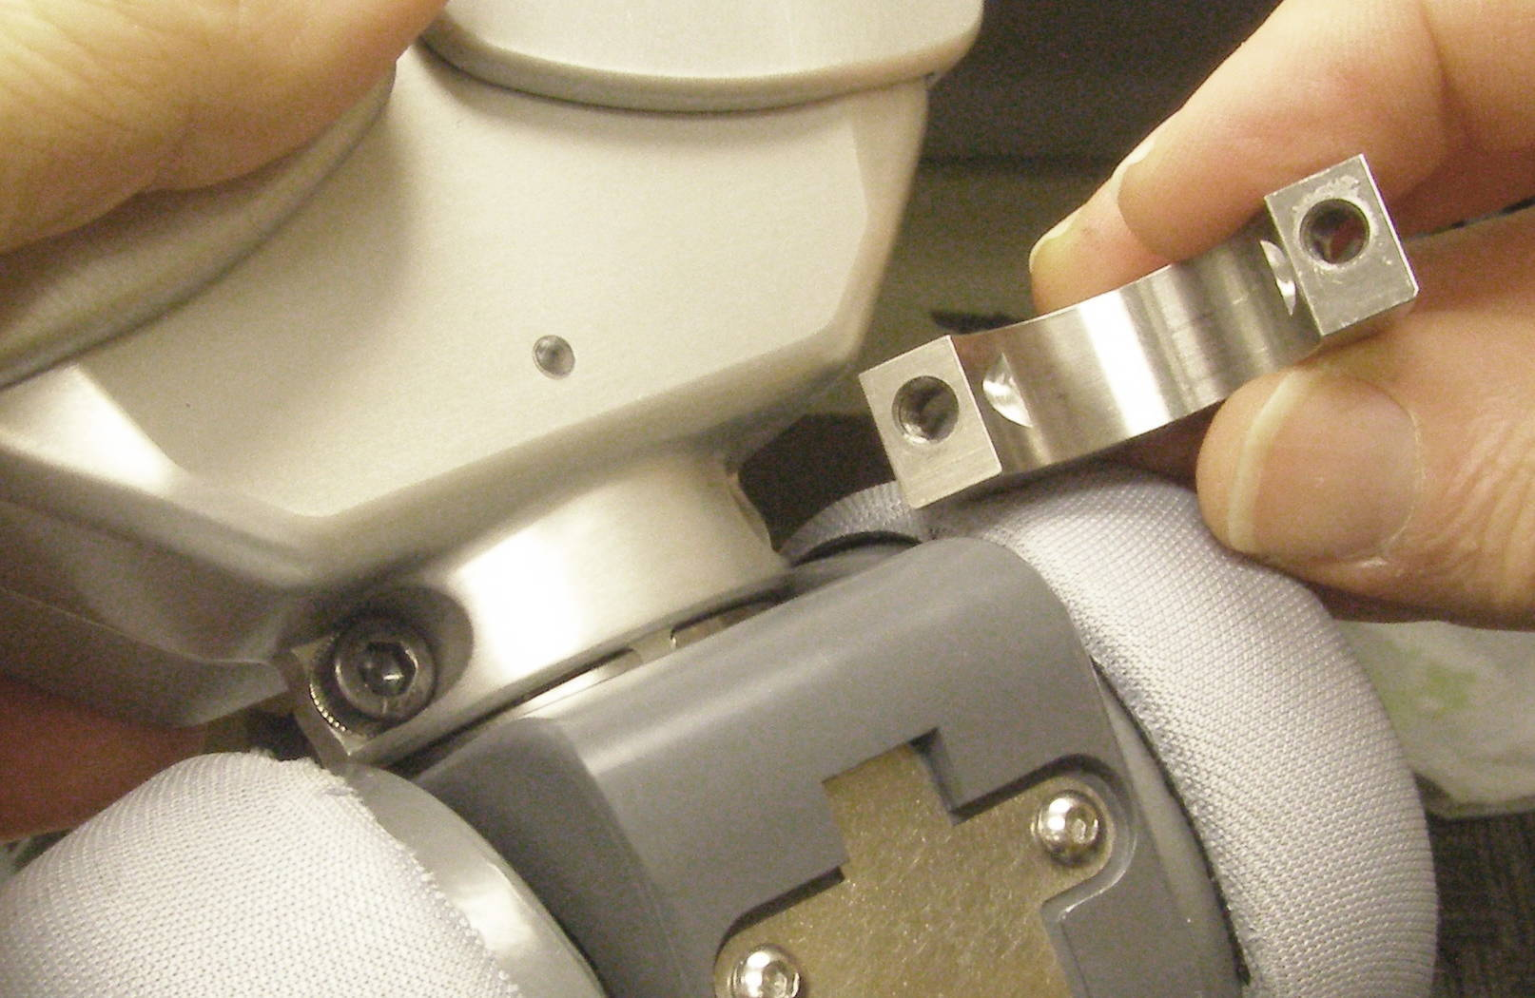
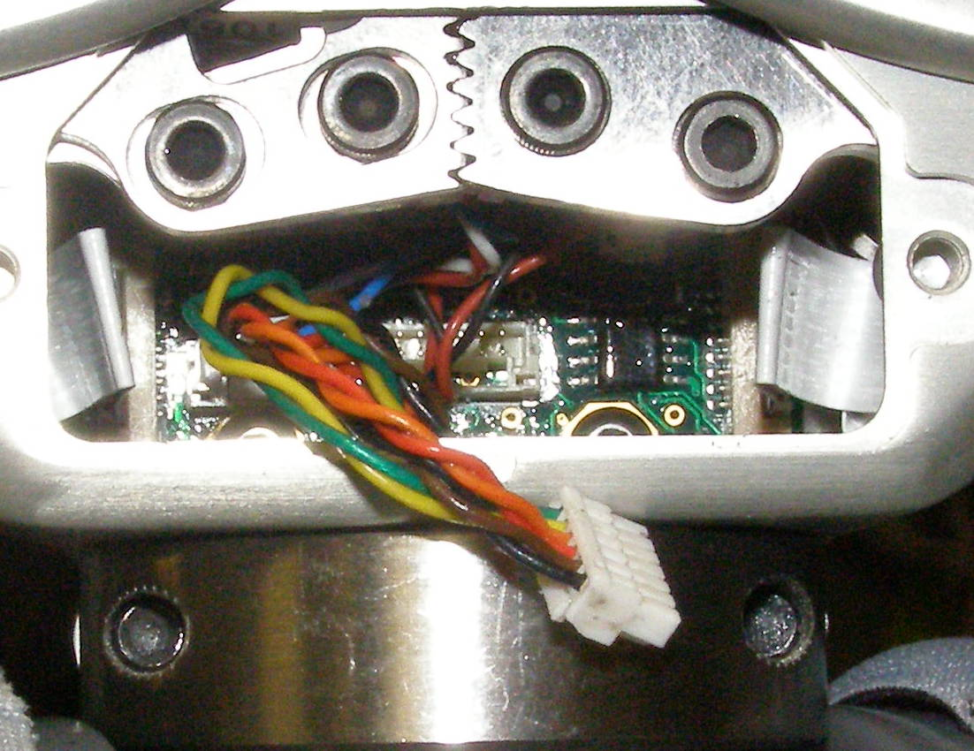
Gripper Removal
Gripper, Removal - 4015
  Using the 2mm bit with the T-handle driver, remove the 2 screws retaining the Palm Door - 1098 in place. 3061-05 (Fig 1)
  Using the Needle Nose pliers squeeze the white connector, so that the latch is released, and gently pull to remove it. (Fig 2,3)
  Using the 4mm bit with the T-handle driver, remove the 2 Gripper Clamp - 2299 screws. 2302-12 (Fig 4)
  With the alignment boss visible pull the Gripper towards you to remove. The Gripper will probably be a tight fit and may require gently rocking it to remove it. Be careful not to damage the loose cable. The clamp will typically come loose during this process. (Fig 5)
Fig 7
Fig 4
Fig 2
Fig 5
Fig 3

Slide 6
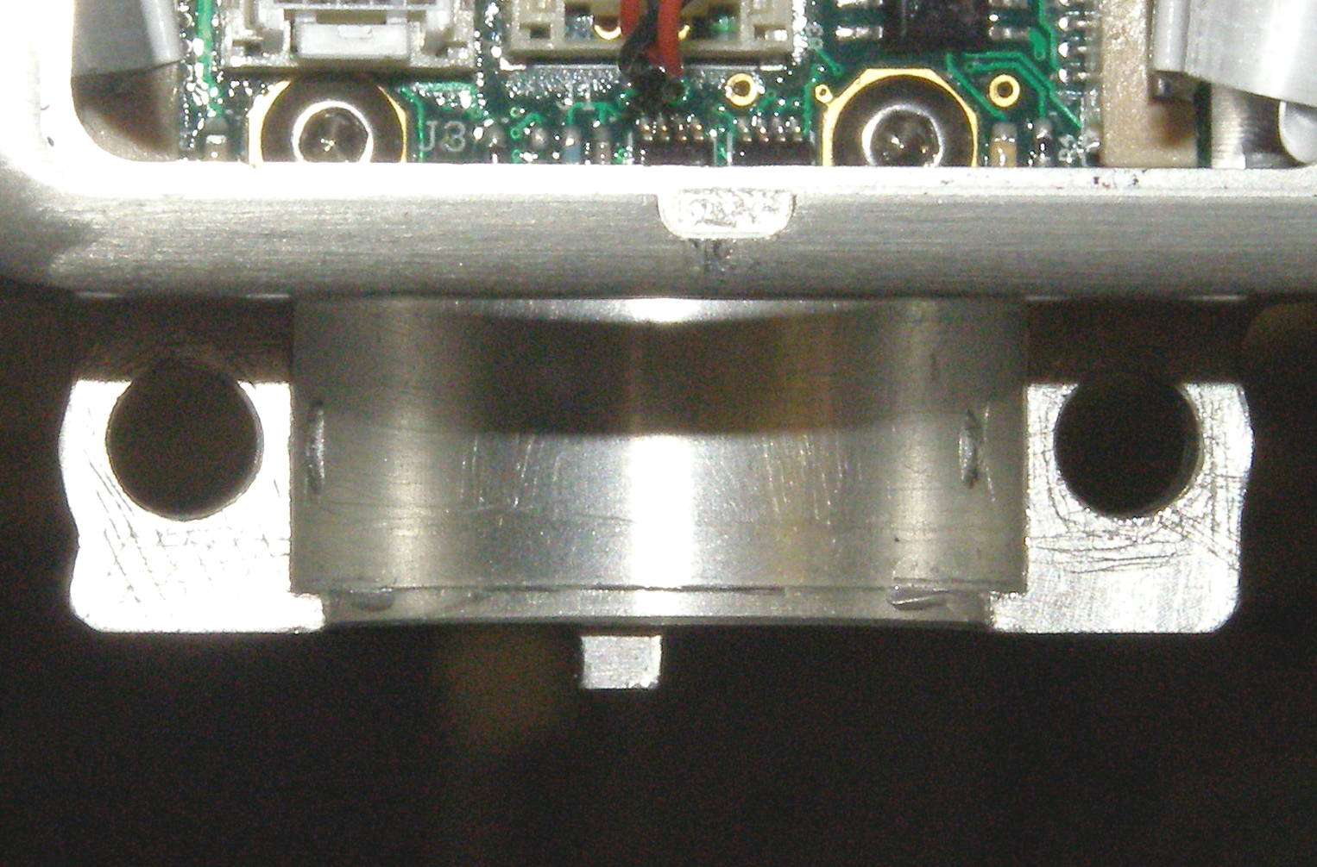
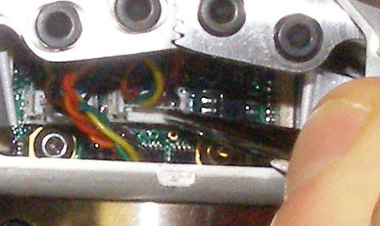
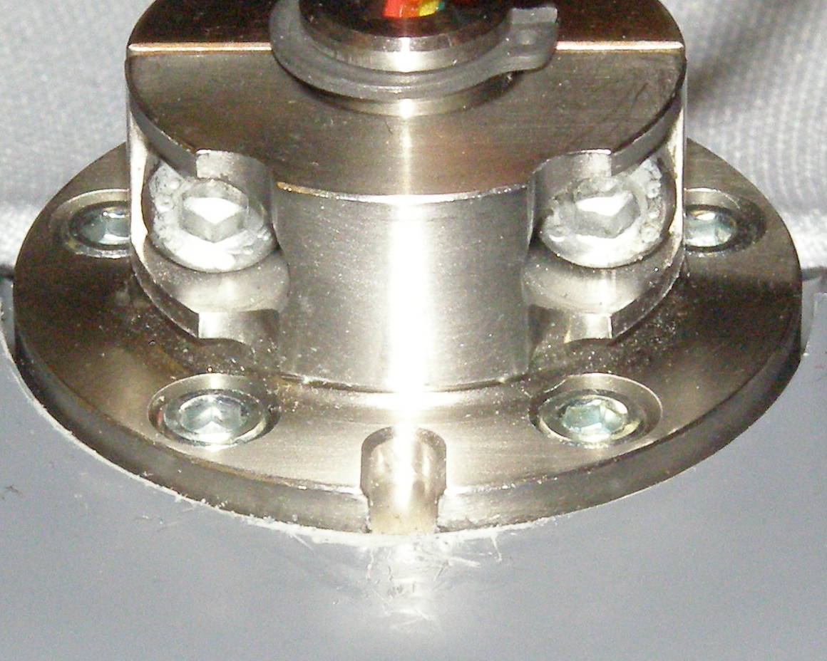
Gripper Install
Gripper, Install
  Mount the Gripper so that the retention flange is in the mating groove. (Fig 6,7)
  Make sure the clamp is orientated with the screw holes up. The Gripper alignment tab must fit into its slot. (Fig 8)
  Using Loctite 242, install the 2 clamp screws and torque to 6.34Nm using the Large torque driver.
  Using the Needle Nose pliers install the white connector. Make sure it is fully seated by gently pressing on the end after insertion. (Fig 9)
  Using Loctite 242, install the 2 Palm Door screws and torque to 1.36Nm using the Large torque driver.
Fig 9
Fig 6
Fig 7
Fig 8

